Slide 1
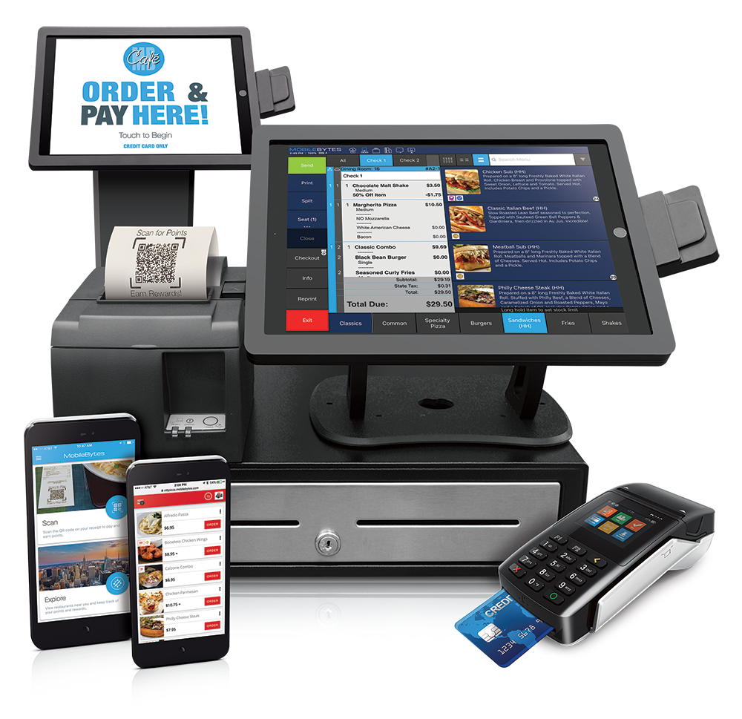
RETAIL SALE system SIMULATION
Raditya Fahritama – JC Data Science Program
Notes:
Dfsdfdsf asdasdsadsa

Slide 2
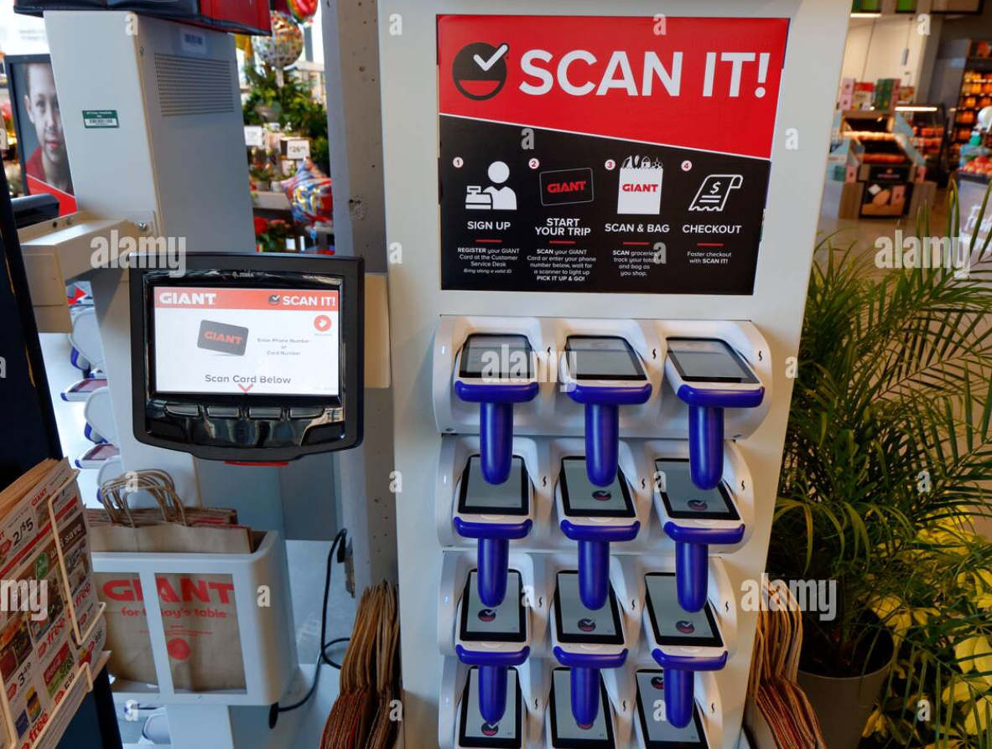
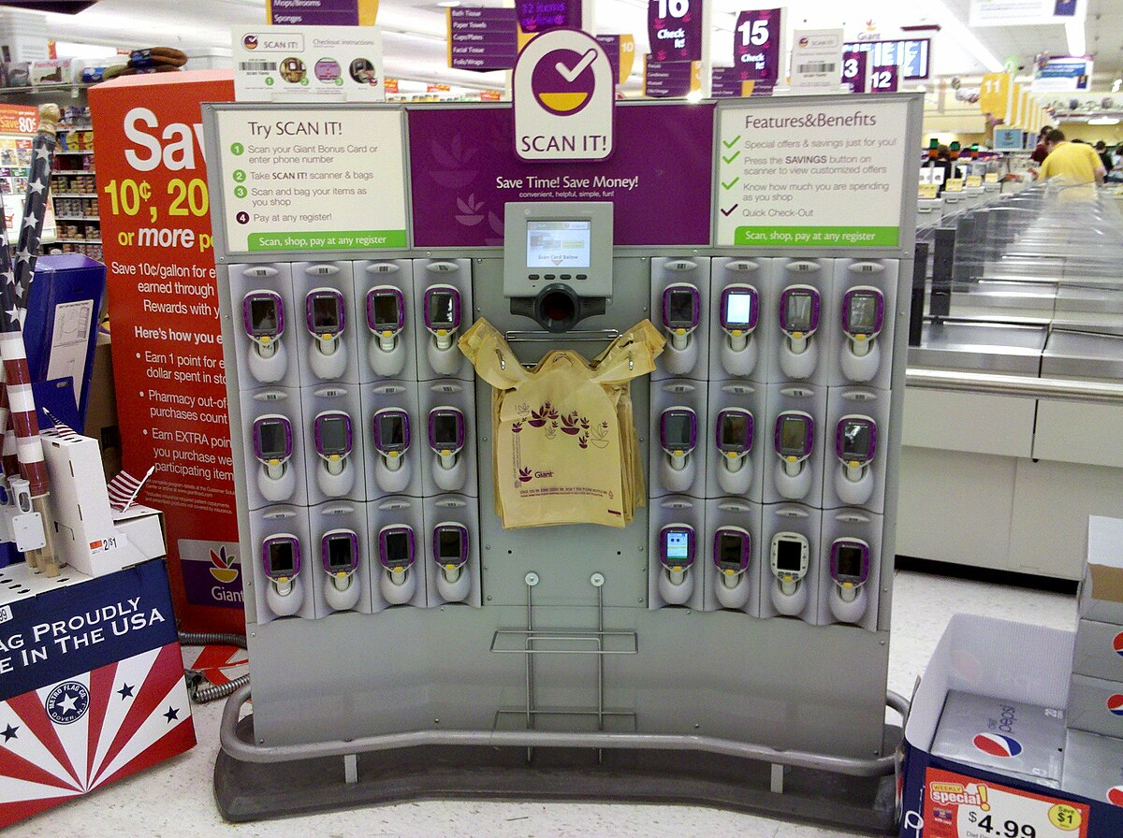
MOTIVATION
Inspired by 'SCAN IT!' by Giant Food Stores that offers an easy way to shop. With 'SCAN IT!’, customers can scan items directly as they go while shopping, resulting in a faster checkout process. The primary emphasis of 'SCAN IT!' lies in its focus on convenience and speed. The purpose of this app is to replicate the main keys and functions of 'SCAN IT!' with some limitations and changes

Slide 3


USERs OF THE APP
- View products available in the store either by applying filters or by viewing the entire selection
ADMIN
- Maintain customers’ data by performing CRUD actions
CUSTOMERS
- Maintain processed transactions of customers
- Search customer’s transactional details and history
- Maintain inventory data by performing CRUD actions
- View and maintain items in their carts by adding items, removing an item, or clearing items in cart
- Check out items in their carts and move them to processed transactions
- Top Up money balance used in the app

Slide 4


DATA COLLECTIONs used
USER - DICTIONARY
ITEM - DICTIONARY
LISTS TO CONTAIN TRANSACTIONAL DETAILS
Key : UserCode
Value: List of user’s details:
Name, Address, City of Residence, Phone Number, Balance, Empty Dictionary used to contain user’s cart items
First element contains admin’s key and admin’s password only
Key : ItemCode
Value: List of item’s details:
Name, Price, Stock of item, item’s discount rate, item’s category
​​​
transaction_history : contains customer’s code that made transaction
transaction_history_amount : contains total of money spent by customer
Processed_transaction : contains transaction details that have been received by the store

Slide 5

LET’s MOVE ON TO THE APPLICATION DEMO

Slide 6

WHAT CAN BE IMPROVED?
1
Create password for each user’s data for more protection and better index growth.
2
Create simplified menu choices, better escape method, and better update method that can select wanted column only.
3
Add Individual item checkout process ignoring other items in cart, add way to change delivery address, add more filters to the items view
4
Save the data to external file like txt file for reusability

Slide 7
THANK YOU!

